Slide 1

The Rise of Anime

Slide 2
Anime

Slide 3
The miscellaneous birth of Anime

Slide 4
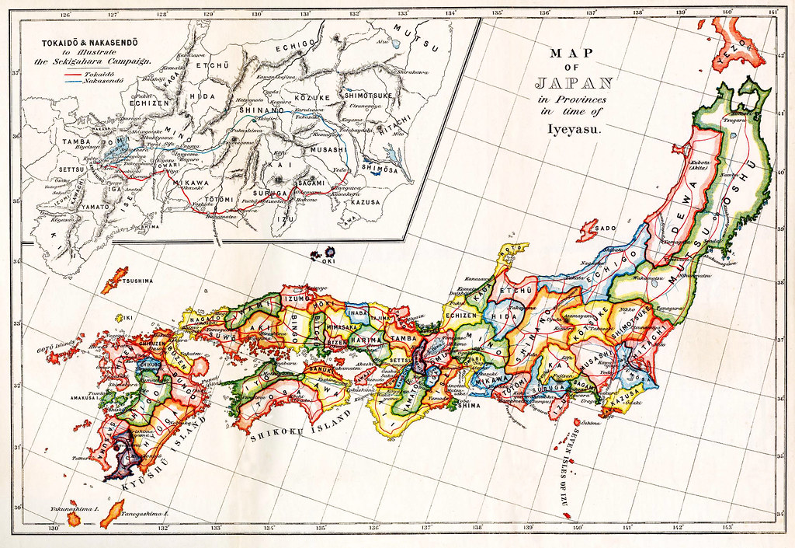
The Japanese Society 1800s

Slide 5
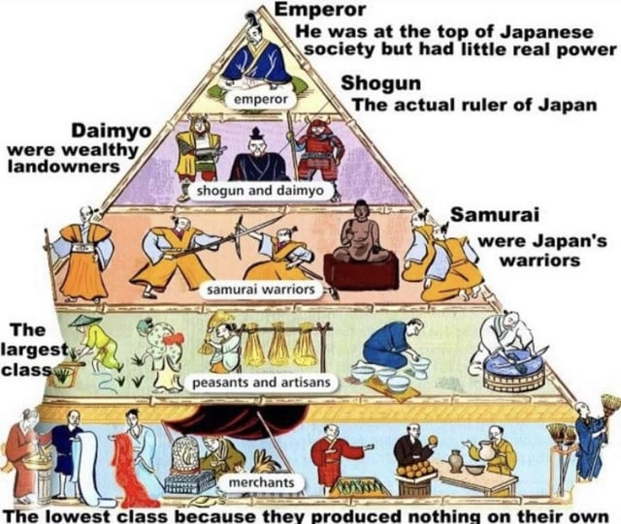
The Japanese Society (Social Structure)

Slide 6
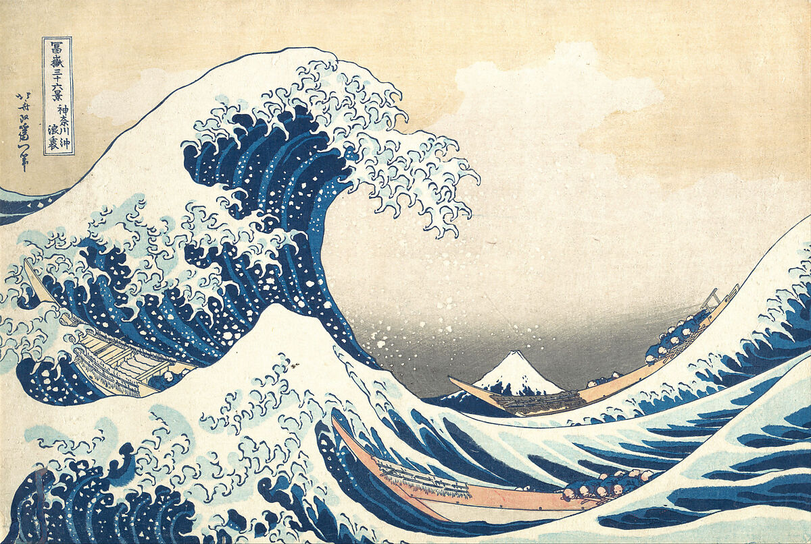
The Japanese Society (Art Patronage)

Slide 7
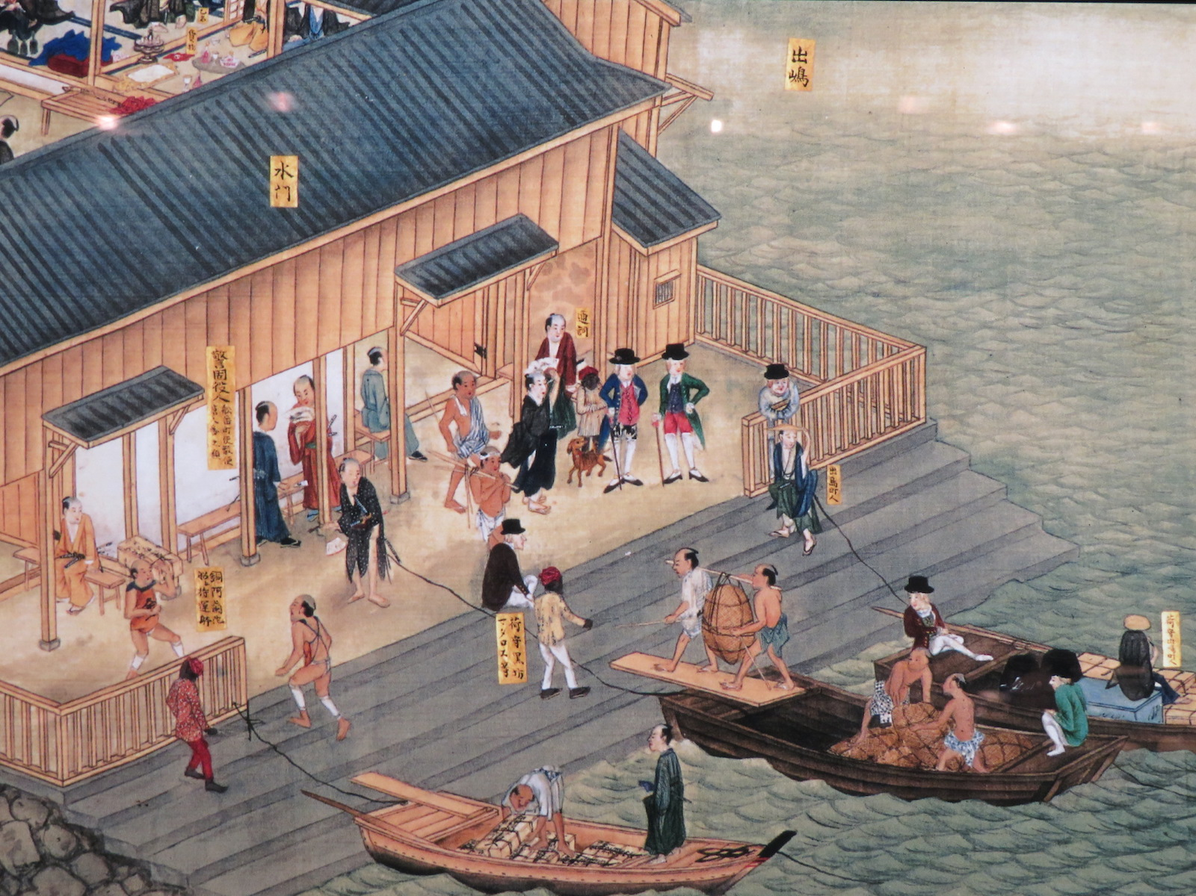
The Japanese Society (Dejima Port)

Slide 8
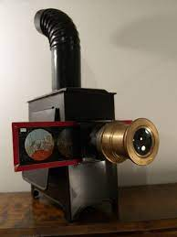
The Japanese Society (Magic Latern)

Slide 9
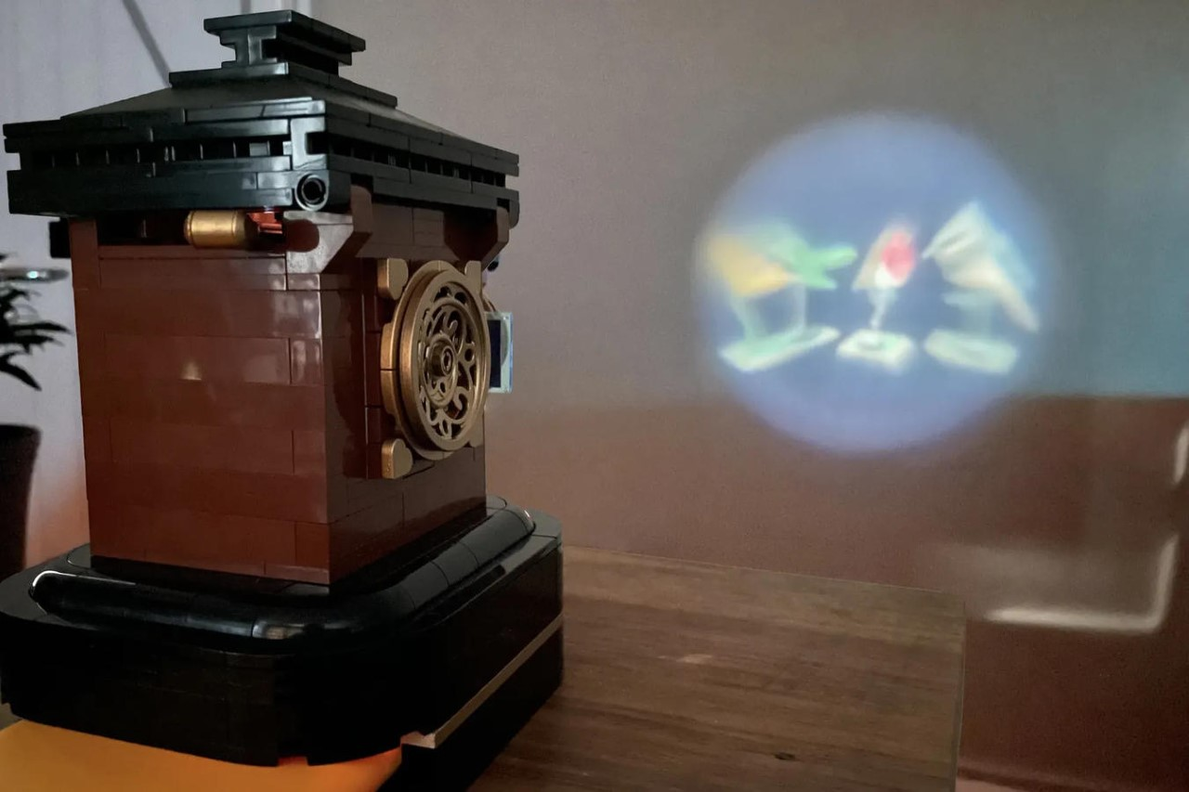
The Japanese Society (Magic latern)

Slide 10
Globalization of Japan
- For US Japan would be a beneficial port for resupplying and
- United Stated (Black Ships) gave them an ultimatum of Signing a trade agreement or be destroyed
- Humilated and having the fear of becoming yet another western colony, Japanese gave in (March 31, 1854, The Treaty of Kanagawa)
- This led to other countries come with their own trade agreement, no alterations were allowed stating that Japan wasn't a modern society.
- At this point Japan was a collection of semi-autonomous regions.
- Unified by common enemy
- A top-down revolution led by the samurais made the (meiji) emperor the supreme ruler and overthrew the shogun, in a race to avoid being a pawn to the western society
- Feudalism abolished, all land belongs to the Government, class system was dissolved, traditional clothing was replaced by western clothing
- Samurais lost their stipends

Slide 11
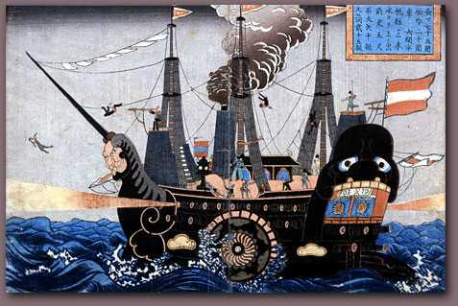
Globalization of Japan (US Trade)

Slide 12
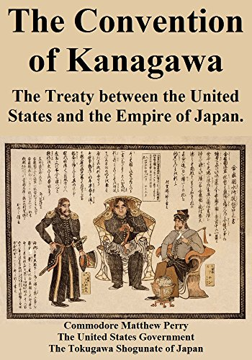
Globalization of Japan (1854: Treaty of Kanagawa)

Slide 13
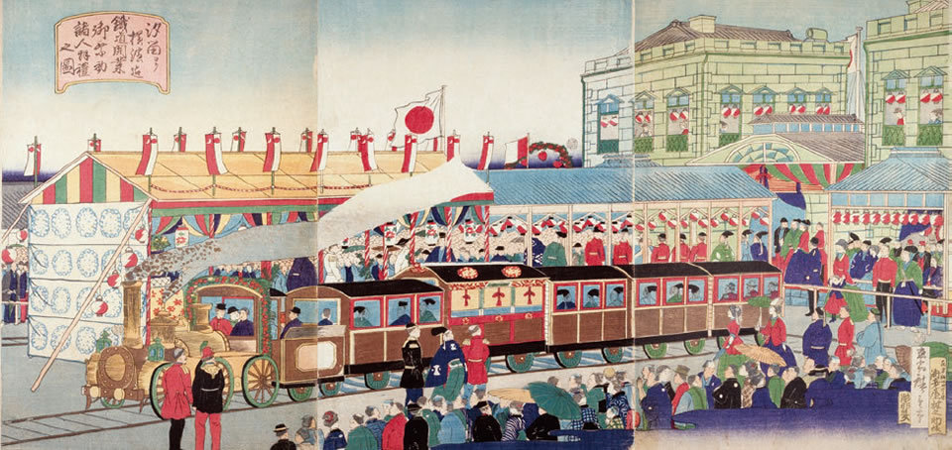
Globalization of Japan (Origin of Modernization)

Slide 14
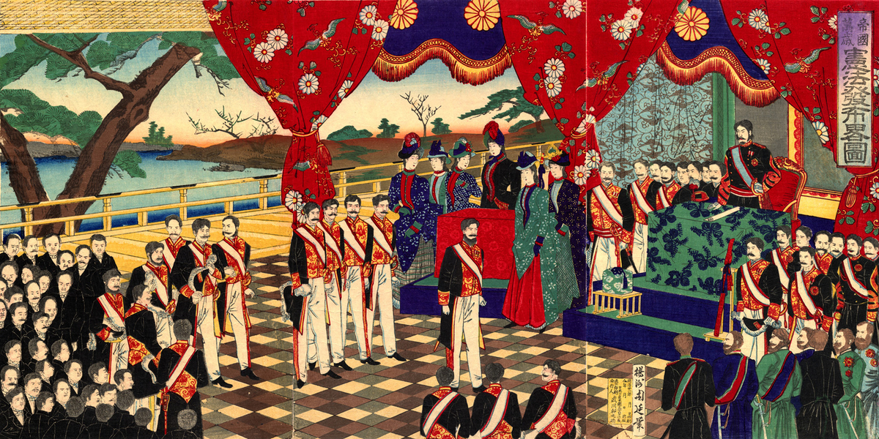
Globalization of Japan (Meiji Restoration)

Slide 15
Exchange of Western Art
- Englishmen Charles wirgman, published The Japan Punch, introducing western comic Styles
- Adapted and reformed by the Japanese cartoon magazine E-shimbun Nippon-chi
- This brought a surge of magazines and paper media, aimed at the highly literate population
- The modern use of the word manga was used by Rakuten Kitazawa, Father of Manga

Slide 16
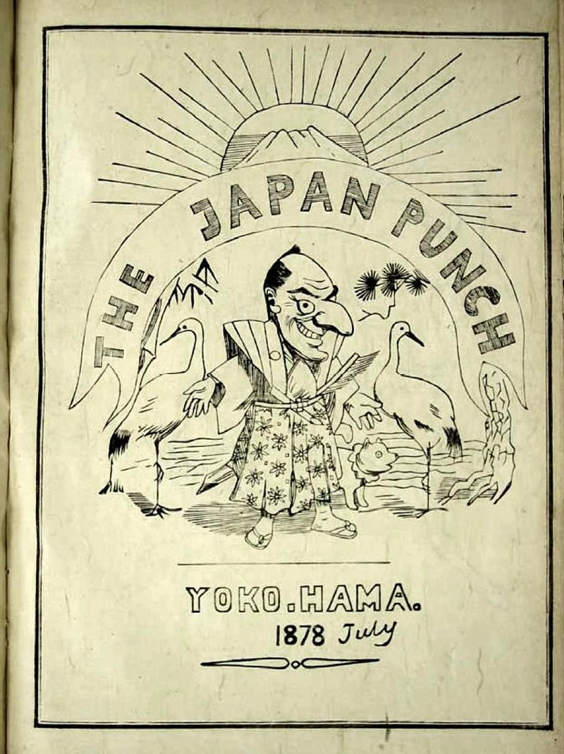
Exchange of Western Art (The Japan Punch)

Slide 17
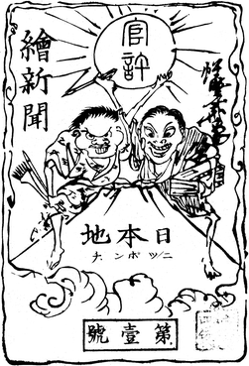
Exchange of Western Art (The First Manga)

Slide 18
Japan on the Road to Modernization
- New industrialized society requires two components, resources to refine and consumers to profit from.
- Japanese military learned from their western aggressors how to secure the supply
- After Japanese ships were attacked and shipwrecked by the aboriginals, the country attacked Taiwan and only agreed to leave when they provided with 18 tons of silvers from the Chinese qing court.
-Employed Gumbo Diplomacy against Korea (Thomas Greenfield), prying them open to international trade.

Slide 19
Japan on the Road to Modernization
- When Japan demanded special privileges in korea, china refused and this sparked the first sino-Japanese war.
- China was already divided hence it was easily defeated
- China was forced to sign the treaty of Shimonoseki, give gave Japan control over Taiwan, liaodongand annexed korea from Chinese Serenity
-1903: the first cinema had opened in Tokyo
-Russia trying to capture Korea, Japan surprised attacked and won the war (First time modern western nation defeated by an eastern nation).
-1910: Japan took formal control over korea

Slide 20
Death of Meiji
- From the reputation of their modern conquest Japan was now considered a fully modernised Empire
- Demanded the abolishment of the unfair trade treaty
- Meiji emperor passed away
- Katsudo Shashin (Unknown date) is considered from this era. Oldest existing Japnese animation in the world
-1917, First Theatrical Anime was created, which is still viewable, Dull Sword, Junichi Kochi
-1918, Urashima Taro.
- This was praised by the pure film movement, an organisatio to modernize Japanese cinema as an art form to promote Japanese culture at international standard

Slide 21
The First World War
- The advent of domestic animation coincided with the first world war, Japan allied with the Great Britain
- Victory: Japan issued the infamous 21 Demands, extending its leases in machuria and Mongolia, and Shandong province
- it also demanded to take over chinas finance, police and southern province of Fujian were rejected and led to anti-Japanese sentiments in China
-WW led to influx in trade (Imports 1.4 -> 6.8 Billion yen),
- Spread of European art forms and cinema led to Japanese films creating more genre films rather than documentaries

Slide 22
Post World War
- With boom came the crash, rising inflation, social unrest, rice riots
- Taiwan and Korean Colonies forced to produce more rice
Economy slowly recovering
-1923, September 1st: Great Kanto Earthquake Struck Tokyo and its surrounding Area, fires and riots
- The Government Deflected the criticism and falsely accused Korean immigrants -> led to 6000 Korean Deaths
- The EarthQuake and Fires destroyed most of Japanese films and media but studios quickly rebounded with renewed spirits but financing was difficult.
-1925, The mountain where old women are abandoned: Moral Messages and quality, Education Ministry started to finance anime production
-1925: The pot, first commissioned Anime
- Because of the available funding professional animation grew rapidly: Disease Spread, the story of tabacco
- rebuilding of Tokyo led to creation of 178 cinemas and they were often accompanied by animated shorts
- Social disparities between the rich and poor led to growth of social activities groups among students and workers, 1926 - Ethnicization of politics

Slide 23
The Golden Era – 1980s

Slide 24
The Golden Era
- 1979: The Iranian revolution, war with Iraq -> oil shortage
- to combat this Japan -> low interest rate -> more borrowing
- More R&D -> More Industrialisation -> More Jobs
- 1985: US, France, Germany, UK and Japan met in the Plaza hotel in NY (The Plaza Accord) -> Reduce price of the dollar
- Increase in purchasing power of Average Japanese Citizen -> Japanese Banks responded by lowering their interest rates even further
- Increase in investment -> Anime Industry
- Japnese GDP Growth in 1980s 4.3%, More than US and European Union
- Less time More money -> Increase in leisure activities
- Big publishing Companies -> Mix Media
- Studio Ghibli
- Space Battleship yamado -> Storyline,

Slide 25
Anime in the Digital Age

Slide 26
The Globalization of Anime

Slide 27
Cultural Imapct of Japan

Slide 28
The Globalization of Anime

Slide 29
Globalization of Anime

Slide 30
The Globalization of Anime

Slide 31
Imapcts on India

Slide 32
The Globalization of Anime

